Slide 1


Capstone Project Masters in Data Science – Nuclio Digital School 27th May 2023 Carlos Eduardo Perrotta Martello Francisco Adriano Oliveira da Rosa Mafalda de Carvalho Monteiro Rodrigo Carvalho Medeiros

Slide 2

01 Context
02 Objectives
03 Methodology and Results
Data Cleaning & Exploration
Data Analysis & Clustering
Sales Forecast Model
MLOps
07 Q&A

Slide 3
Context
01

Slide 4

01 Context – DS Market
Small chain of shopping centers across the USA
Amongst the very latecomers to the digital transformation.
Sales predictions in DSMarket have been always done using very rudimentary approaches, and the margins of error obtained are affecting many areas of the company.
Many of the internal processes within the company (stock estimations, prices optimization, deliveries, stockout predictions, …) are very manual processes
Optimization using AI methods has been included as part of the 5 years plan that the company has drafted.
We will playing the role of Nicole, a Senior Data Scientist, joining the financial department.

Slide 5
Objectives
02

Slide 6

02 Objectives
Data Analysis & Clustering
Portfolio Analysis
Sales Analysis
Clustering
Sales Forecast Model
Develop Machine Learning Model
Sales Prediction
DS Market
Data Cleaning & Exploration
Missing Data (Nulls)
Irregular Data (Outliers)
Unnecessary data-Repetitive Data, Duplicates
Feature Engineering
MLOps
Ownership and Collaboration
Continuous Integration / Continuous Delivery
Reproducibility and Scalability
Monitoring
API (Application Programming Interface)

Slide 7
Methodology & Results
03

Slide 8
03 Methodology & Results
Clean/Explore
Examples:
The column “yearweek” of the prices table had a lot of nulls → These nulls were automatically filled using the command “ffill”.
Examples:
There were outliers in the table “sell_price” → values were substituted with the mean price of the items. (itens HOME_&_GARDEN_2_406, HOME_&_GARDEN_2_178, HOME_&_GARDEN_2_466)
Examples:
Some columns had the wrong data type assigned → data types were corrected.
Some columns had redundant/not enough information → Columns were dropped.
Some rows in the sales table had quantity 0 → Rows were dropped and we saw a reduction of 40 million rows.
Examples:
Hard to work with the sales table as there were many columns → melt command was used to unpivot the d column.
It was impossible to know the final value/price of each sale → tables were merged so that information from different tables could be crossed and new variables were created.
Analysis/Cluster
01 Missing Data (Nulls)
02 Treat Outliers
03 Remove/Correct Data
04 Feature Engineering
Forecast
MLOps

Slide 9
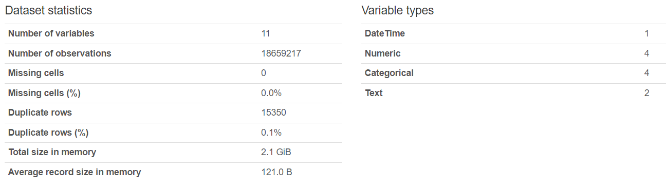
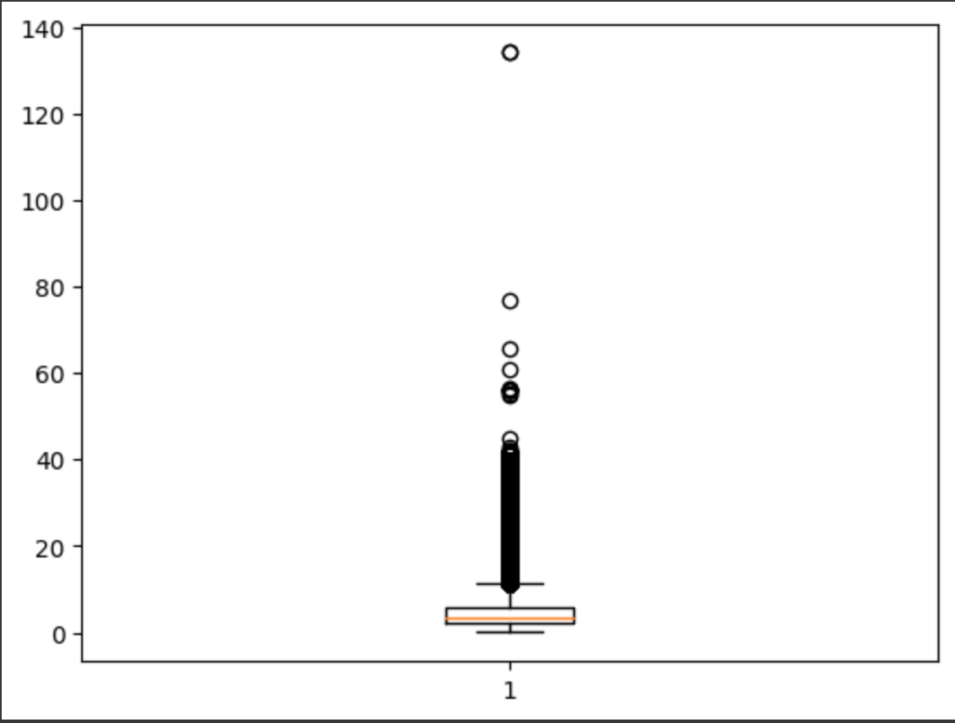
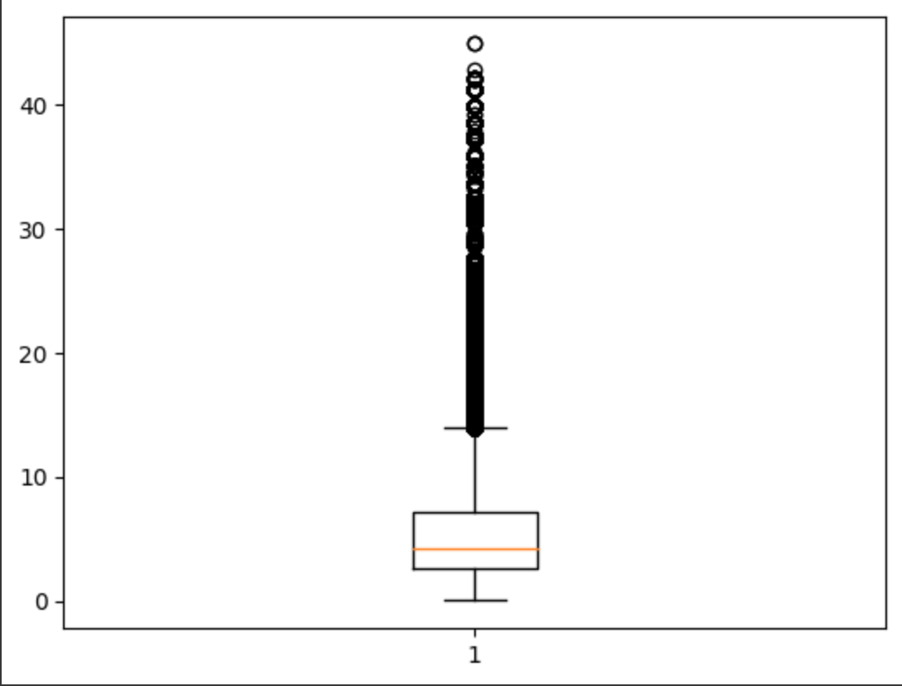
03 Methodology & Results
No Nulls ☺
Clean/Explore
Analysis/Cluster
Before/After Removal of Outliers
Forecast
MLOps

Slide 10
03 Methodology & Results
Find Ideal Nr Clusters
Grid Search
Silhouette Model
Elbow Method
Clean/Explore
Data Analysis
Most/Least sold products
Most/Least selling Stores
Etc.
01
03
05
Cluster Data
Kmeans
Analysis/Cluster
02
04
Forecast
Transform/Grouped Data
by yearweek and qty
by store and qty
by region and qty
Clustering Analysis
K-means
DBSCAN
AgglomerativeClustering
MLOps

Slide 11
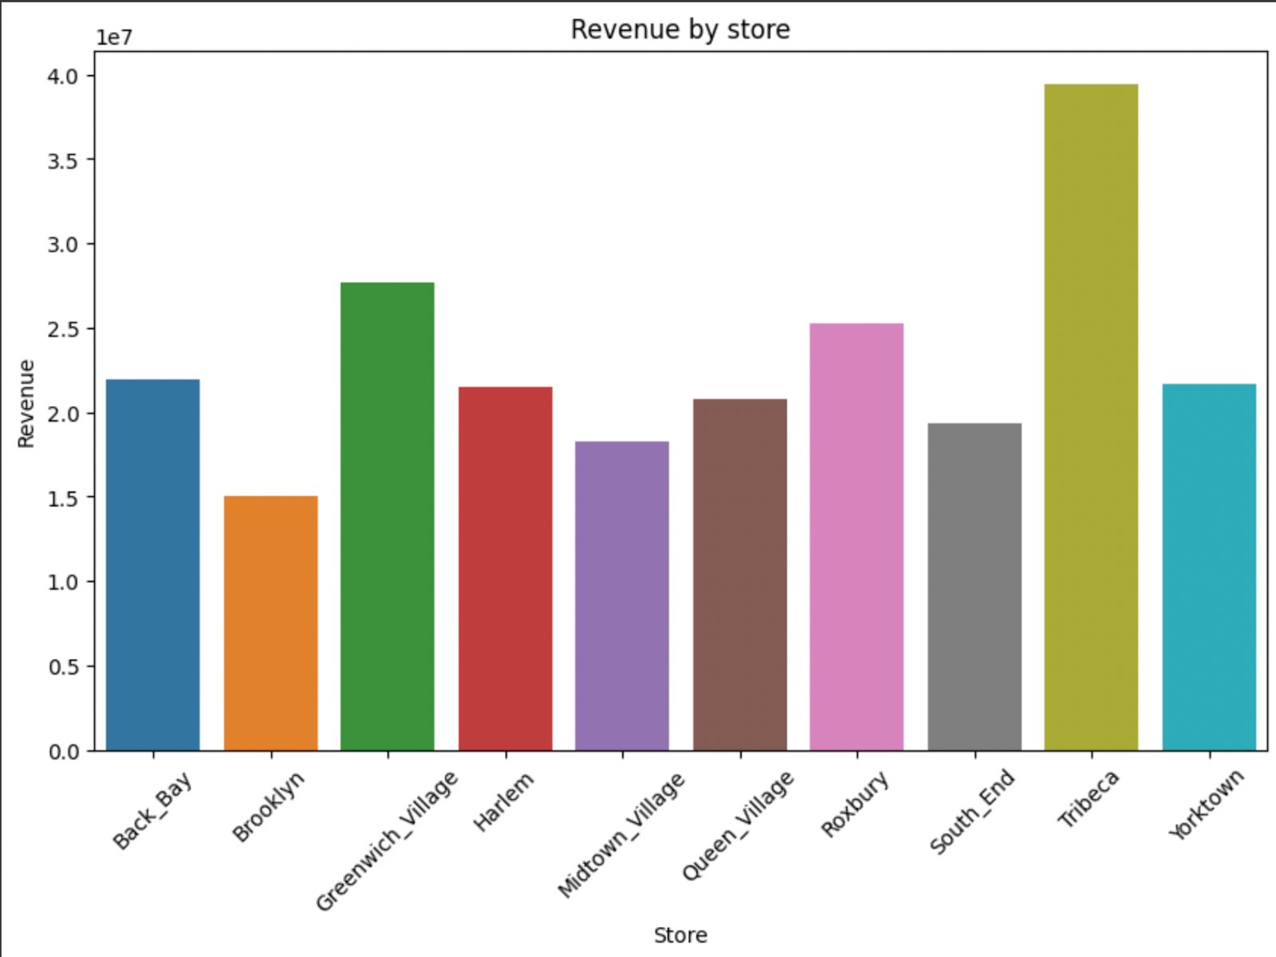
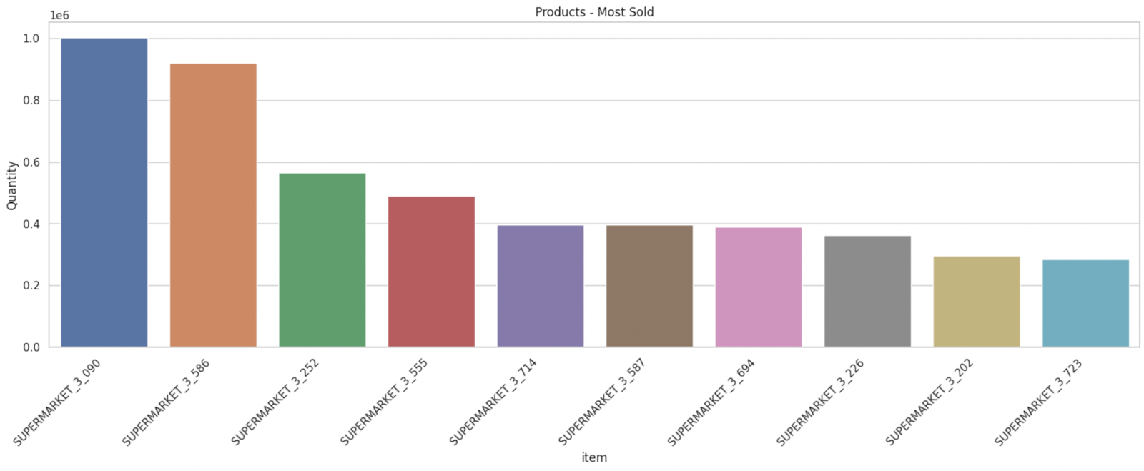
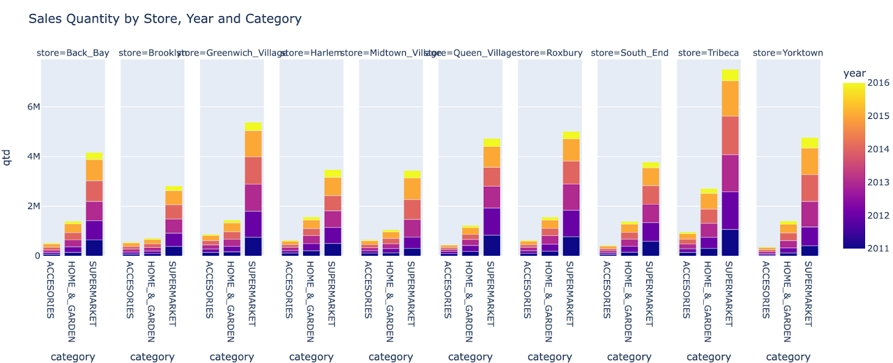
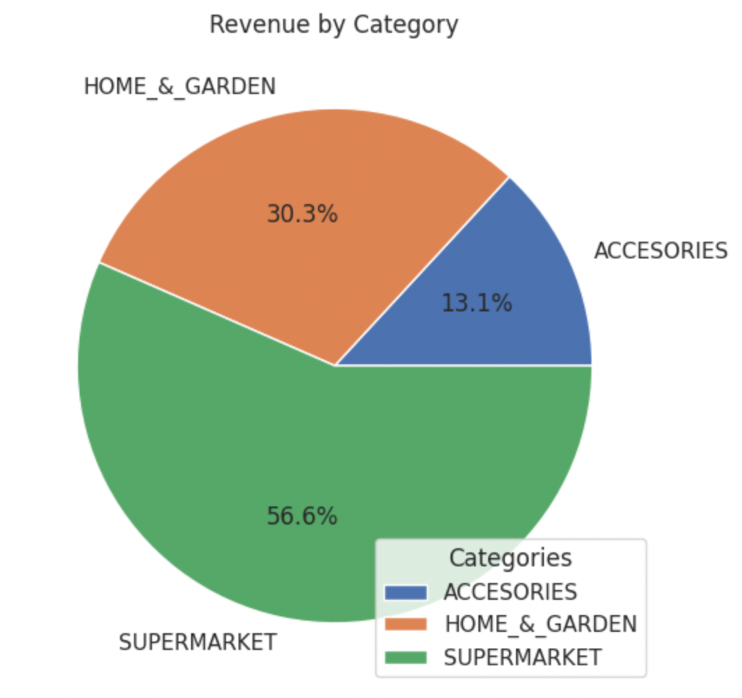
03 Methodology & Results
Data Analysis Examples:
Clean/Explore
Analysis/Cluster
Forecast
MLOps

Slide 12
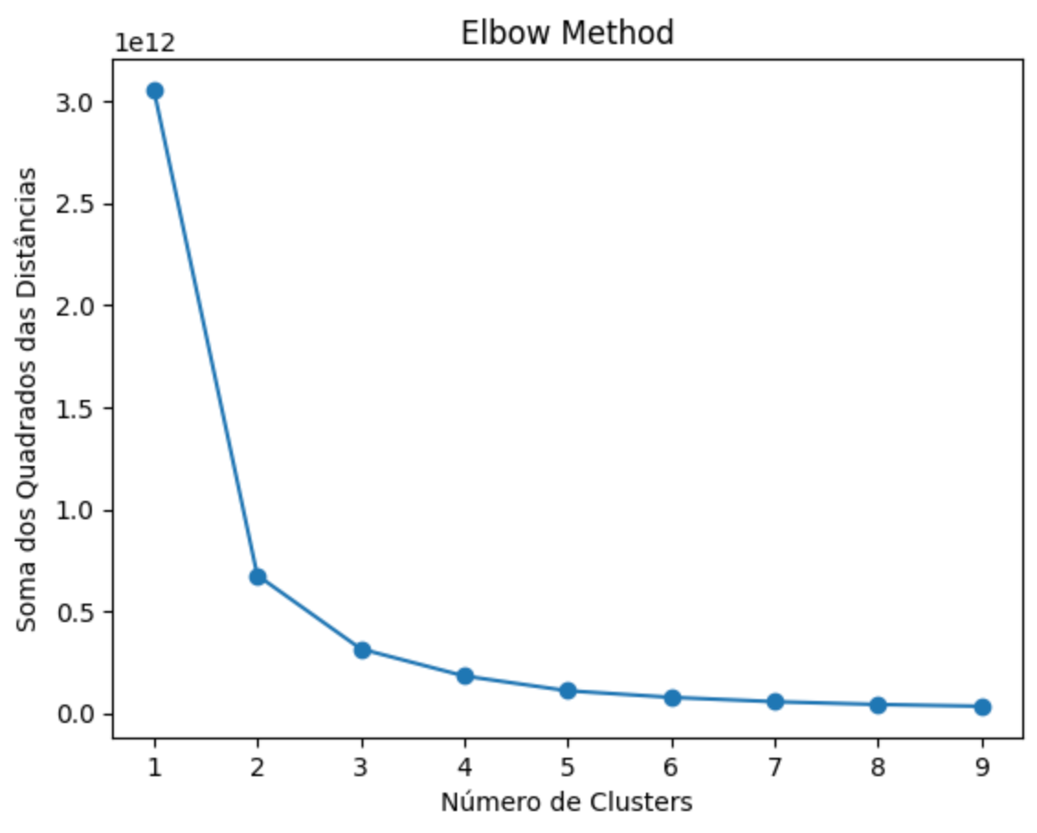
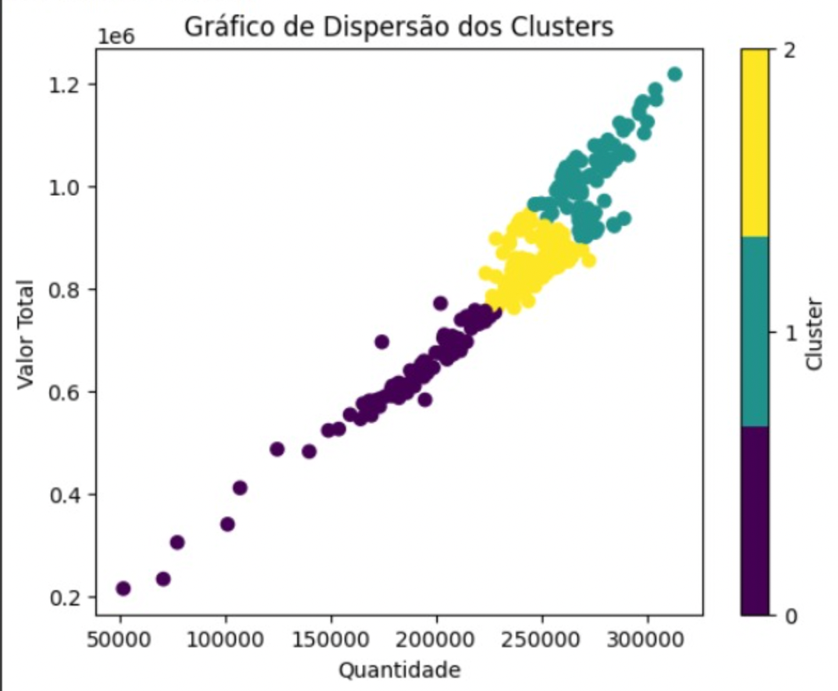
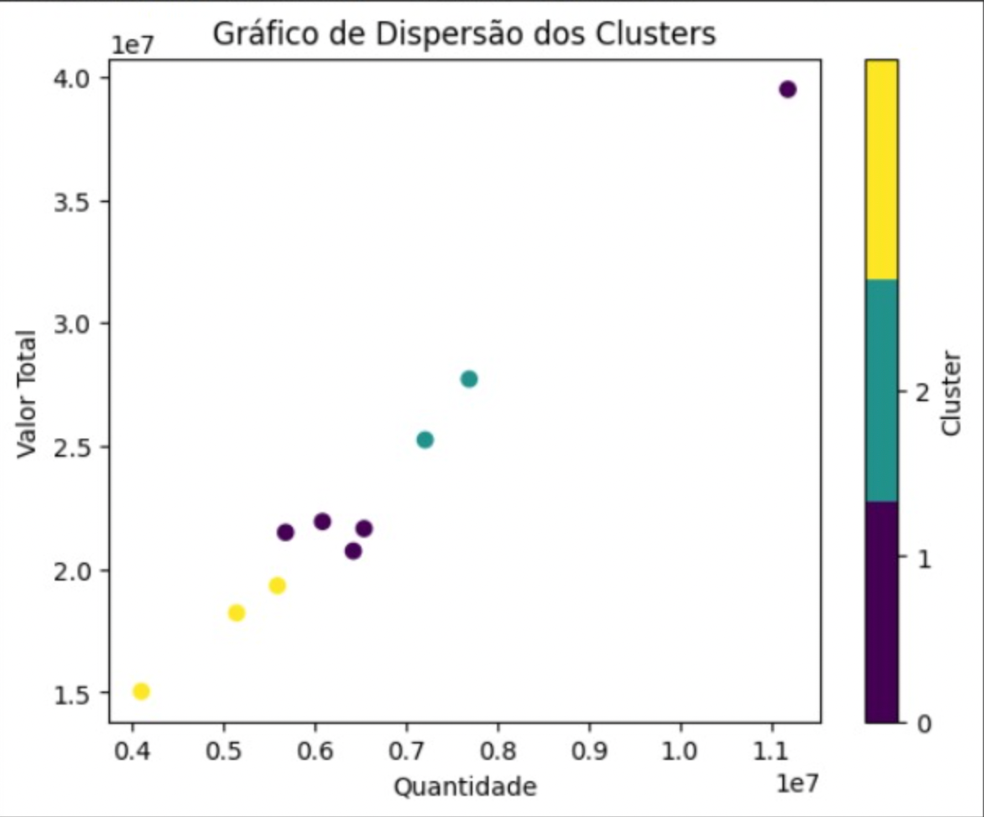
03 Methodology & Results
N=3
Clean/Explore
Analysis/Cluster
Below graphs show the result of clustering using K-means by products (1st graph) and by stores (2nd graph)
Forecast
MLOps

Slide 13
03 Methodology & Results
Clean/Explore
01
Resample Data
02
Evaluate
Data series
03
Generate Forecast Models
04
Choose best
model
Analysis/Cluster
AutoArima
Exponential Smoothing
Holt Winters
Naive Forecast
Other Regressors
Seasonality
Trends
Heteroskedasticity
Measure Error (MASE)
Cross Validation
Aggregation by week
Forecast
MLOps

Slide 14
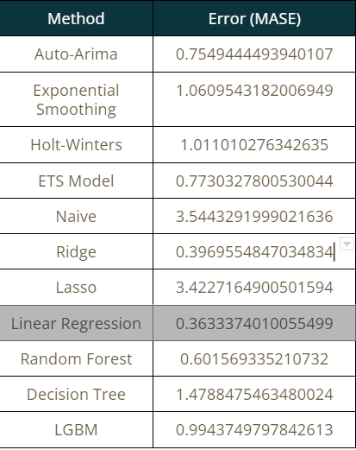
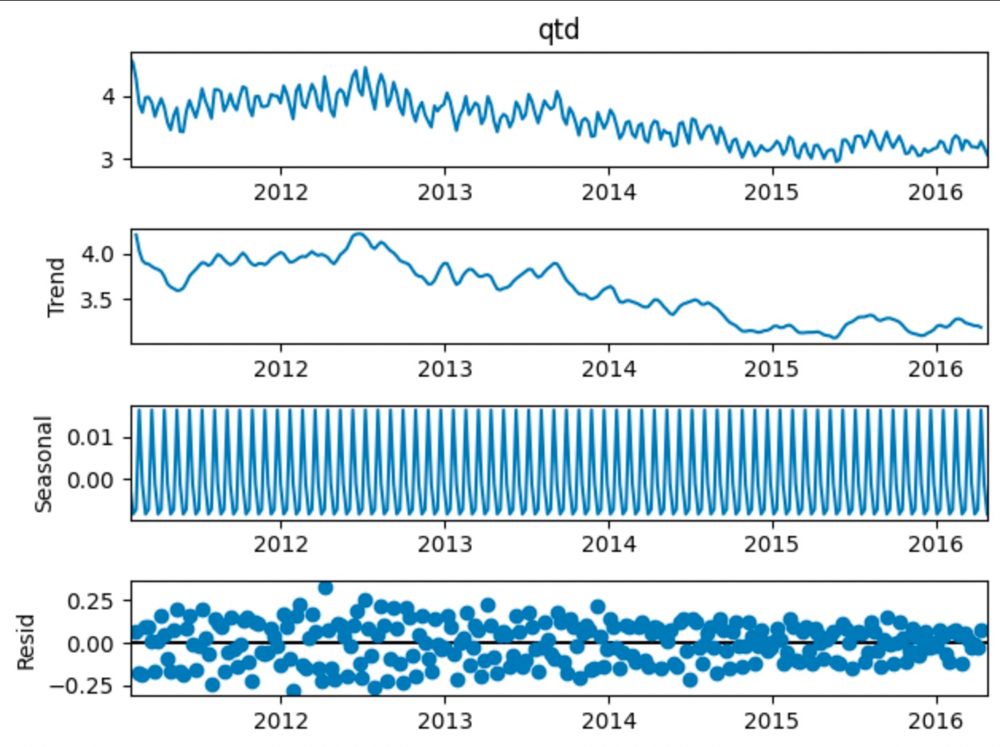
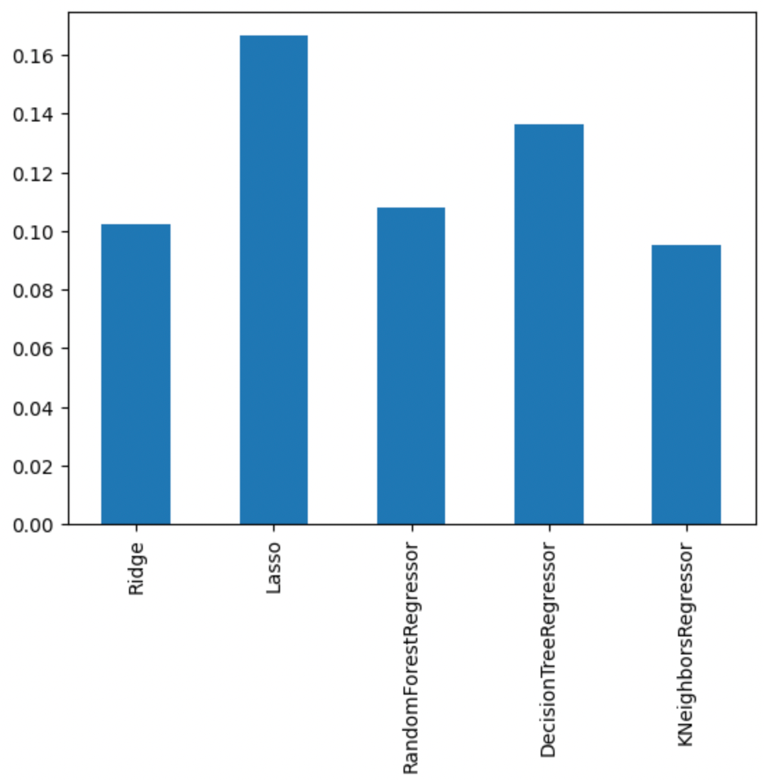
03 Methodology & Results
Clean/Explore
Trend, Seasonality, Residuals
After Cross-Validation
Analysis/Cluster
Forecast
KNeighbors
MLOps

Slide 15
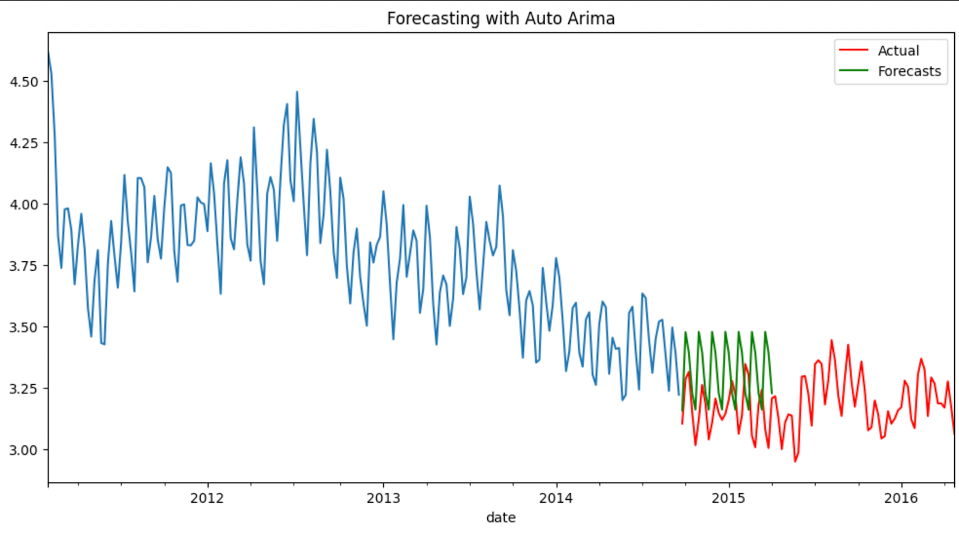
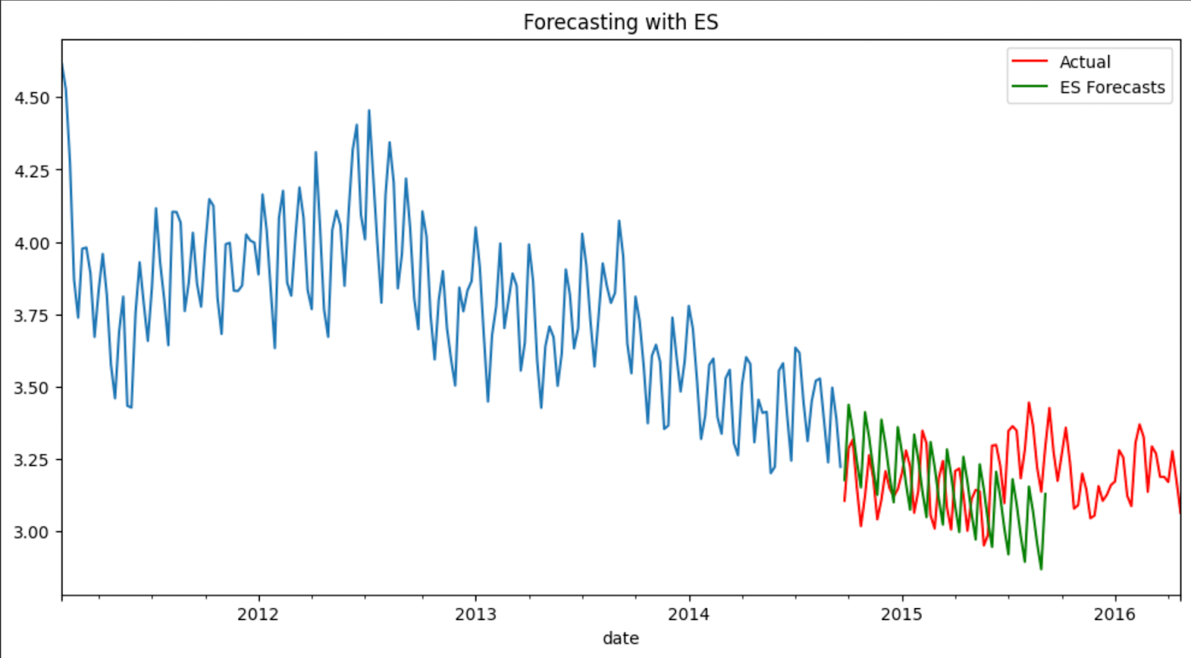
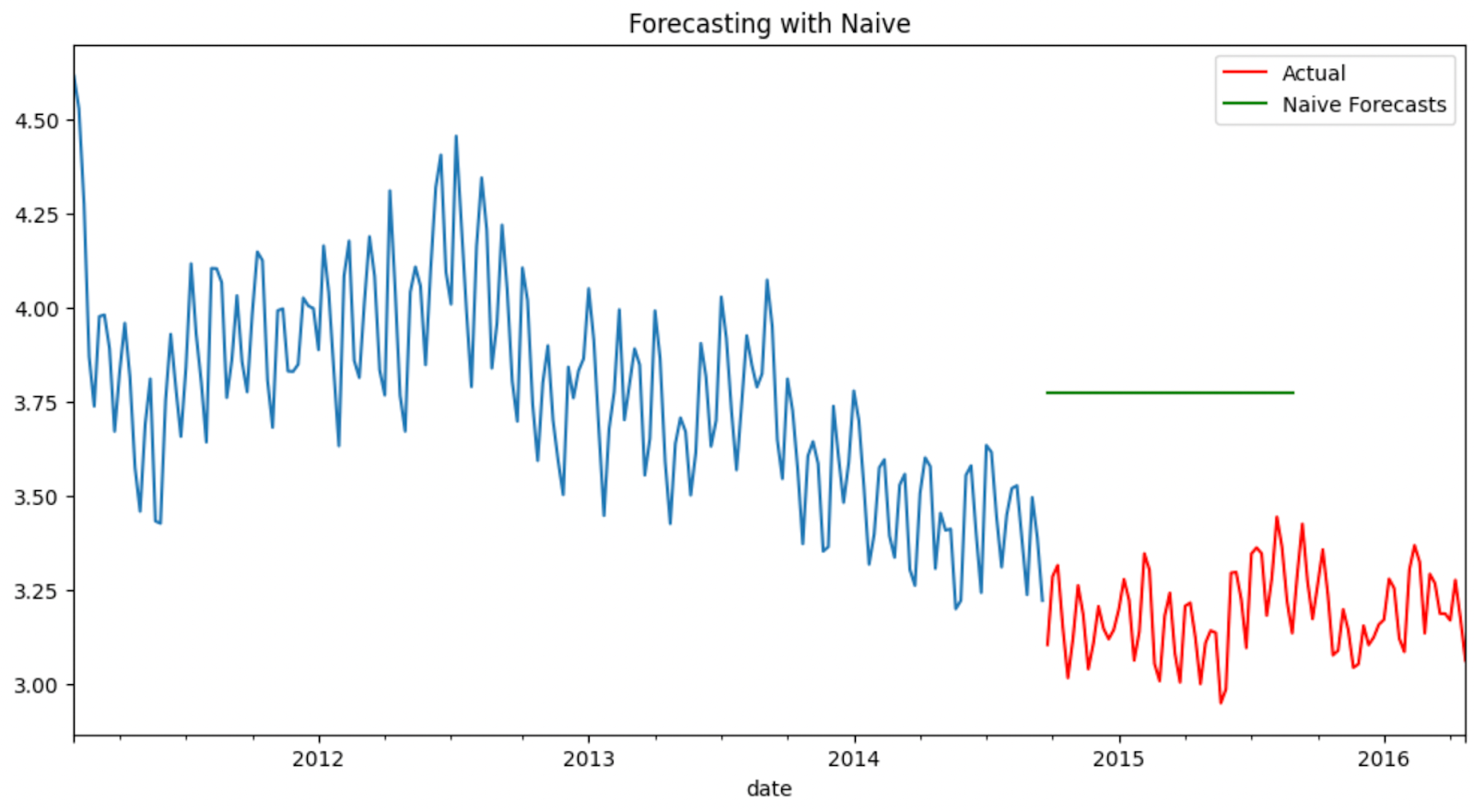
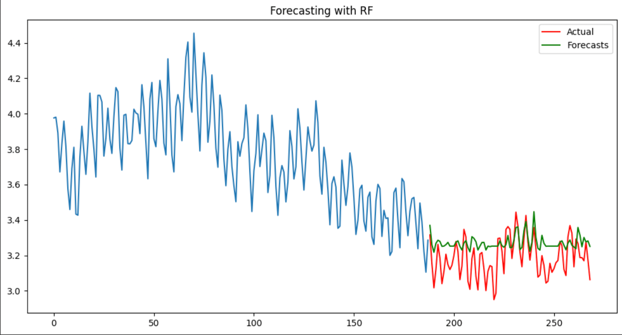
03 Methodology & Results
Some examples:
Clean/Explore
Analysis/Cluster
Forecast
MLOps

Slide 16

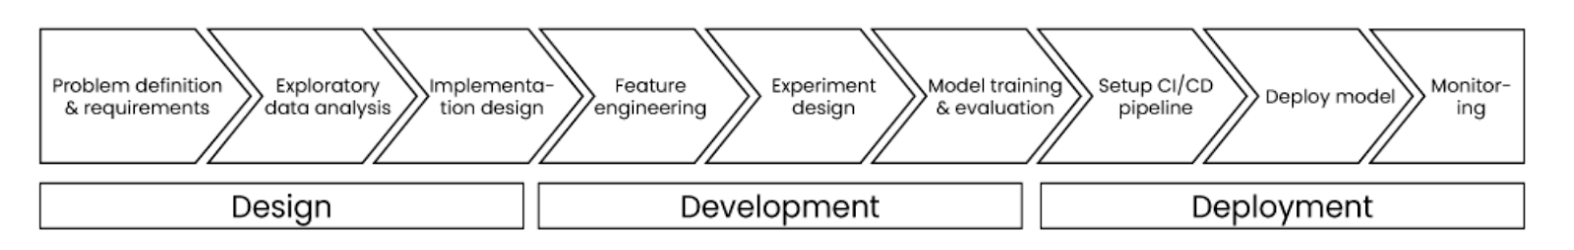
03 Methodology & Results
Reproducibility
Scalability
Clean/Explore
ML Ops
Continuous Integration/
Continuous Delivery
Monitoring
Analysis/Cluster
API
Forecast
Ownership & Collaboration
MLOps

Slide 17
03 Methodology & Results
Ownership & Collaboration
Reproducibility
Clean/Explore
Continuous Integration/
Continuous Delivery
Important that everyone knows his role in the process and that all are synchronized.
we recommend that the agile methodology is followed
Automated testing
Ensures that the code and models are always up-to-date and ready for deployment/available to end-users.
Use version control
Use random seeds
Containerization
Analysis/Cluster
Scalability
Monitoring
API
Optimize the code
Use cloud-based infrastructure
Performance Monitoring: F1-score, and AUC-ROC, can be used to monitor the model's performance.
Concept Drift Monitoring
Choose an API framework
Define the API endpoints
Integrate API
Forecast
MLOps

Slide 18
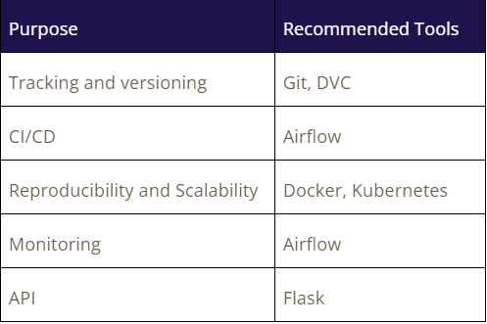
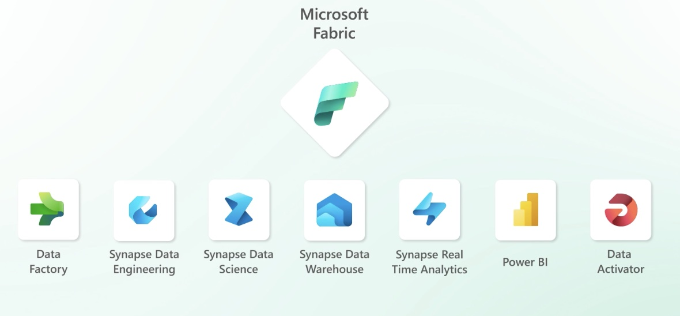
03 Methodology & Results
Clean/Explore
Analysis/Cluster
Microsoft Fabric – New Launch July
Forecast
MLOps

Slide 19
Q&A Thanks for listening ☺
04

